Slide 1
Project Ihy
Braden Arestides, Eric Henggeler, Thadeus Ross, Grace Gamstetter

Slide 2
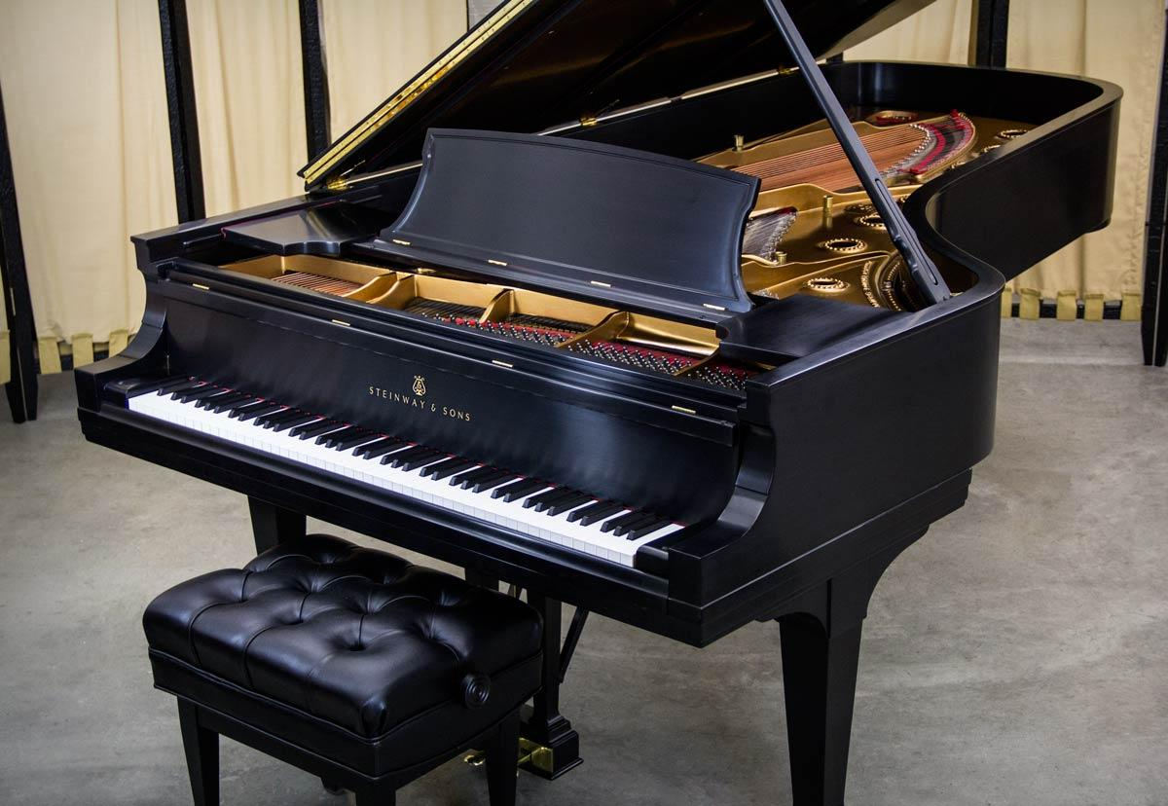
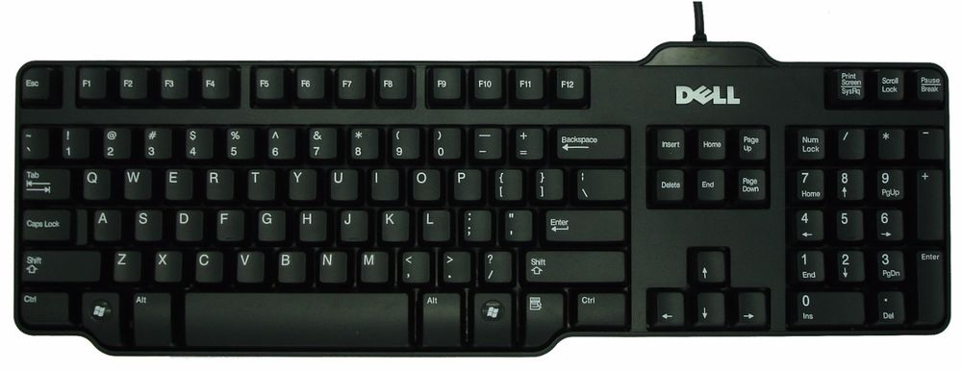
Logo (v1)

Slide 3
Group Information
Advisor: Anca Ralescu
ralescal@ucmail.uc.edu
Braden Arestides
arestibp@mail.uc.edu
Eric Henggeler
henggeew@mail.uc.edu
Thadeus Ross
rosstu@mail.uc.edu
Grace Gamstetter
gamstegl@mail.uc.edu

Slide 4
Project Abstract
The world is full of creative and talented musicians, but many of them don’t have the full skillset of creating a full composition on their own.
Ihy is a music synthesizing tool which will create harmonizing pieces to complement a user-provided musical melody. It is a plugin for the popular tool called MuseScore, an open-sourced platform for creating scores for many different instruments and genres of music.
Ihy will assist composers by eliminating tedious composing sessions for background pieces and allow them to focus more on the most important aspects of a musical score.

Slide 5
Purposes and Goals
Create an easy to use but powerful tool for assisting composers with creating complete songs
Contribute to the Musescore open source community

Slide 6
User Stories
As a composer, I want to listen to the harmonies produced by the tool so that I can have an accurate representation of what they sound like.
As a composer, I want to generate a melody based on a chord progression so that I can write exciting music.
As a composer, I want to generate accompaniment for already existing song elements, in order to more fully flesh out a project.
As an arranger, I want to be able to generate harmonies to given melodies so that the song can have more depth.

Slide 7
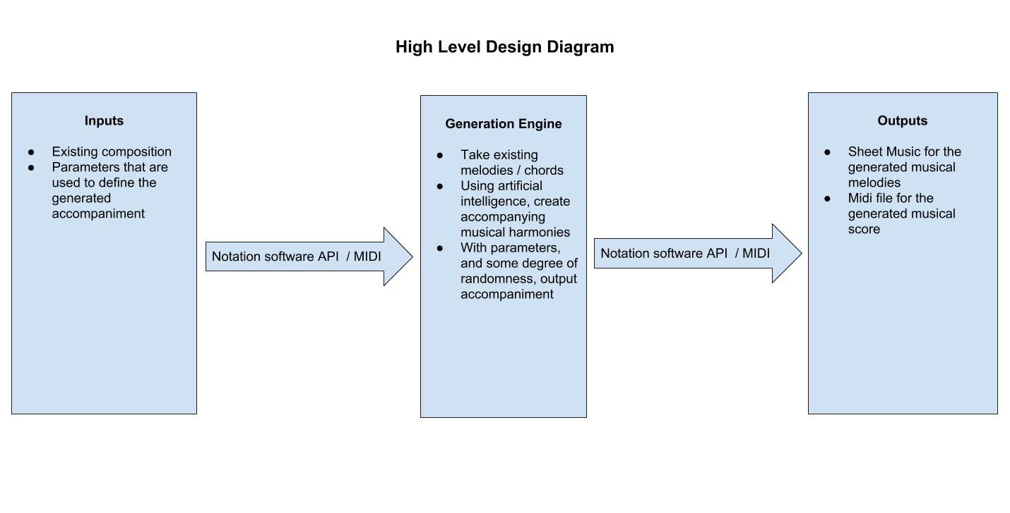
Design Diagrams

Slide 8
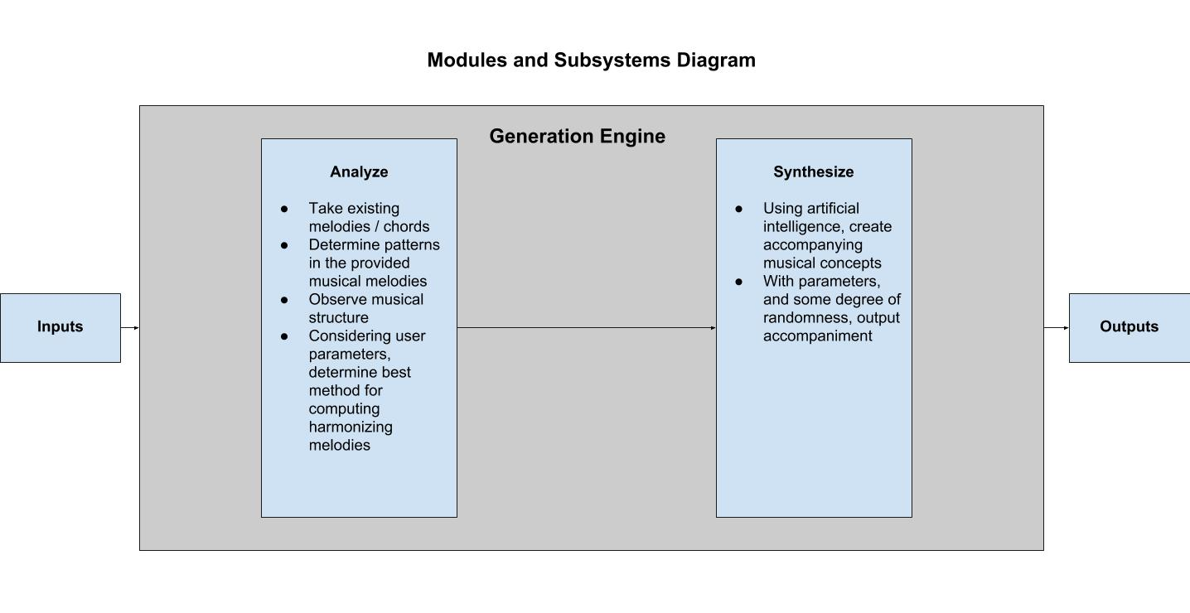
Notes:
Analyze by observing musical patterns and structures to give a context.
Using parameters specified by the user, the engine can synthesize new notes with a certain degree of randomness.

Slide 9
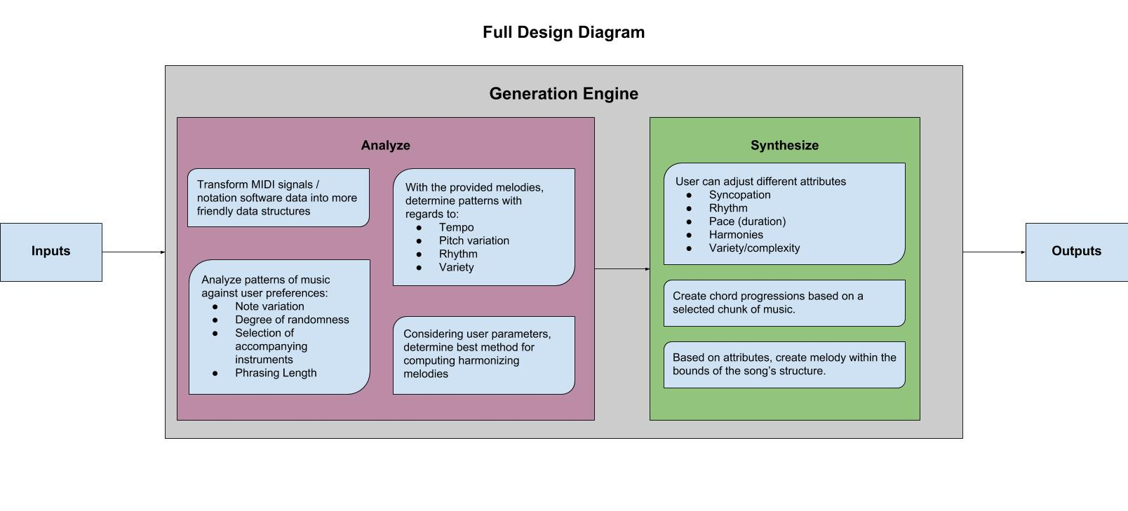

Slide 10


Example
User Provides:
And says they want more syncopated. Ihy would output something like this:

Slide 11
Division Of Work
Thadeus - Interface between user and program
Grace - Analyzing music which is provided by the user
Braden - Synthesizing new music to harmonize with the user-provided score
Eric - Packaging the music into files and scores to provide the user

Slide 12
Questions / Feedback?
Contact info:
Braden Arestides
arestibp@mail.uc.edu
Eric Henggeler
henggeew@mail.uc.edu
Thadeus Ross
rosstu@mail.uc.edu
Grace Gamstetter
gamstegl@mail.uc.edu

